Slide 1
ENGR 12
Dr. Mandala
Notes:
Down

Slide 2
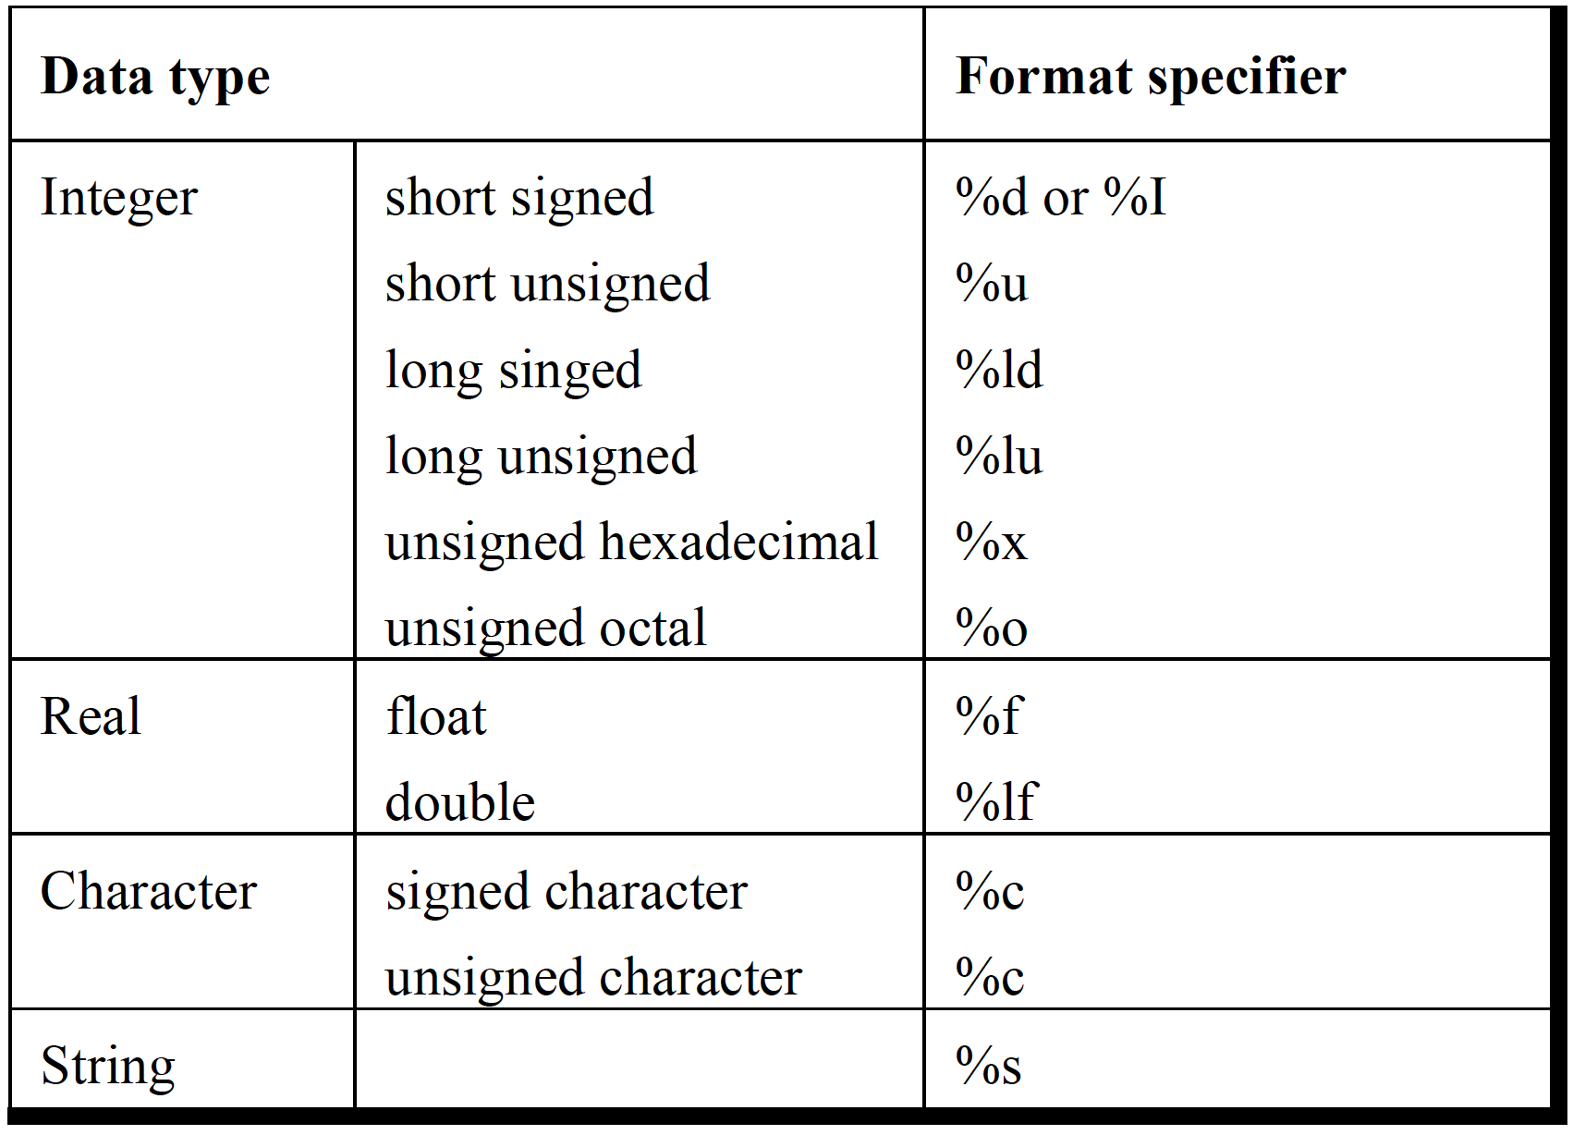
Printf
How do you print an address? How do you print an value as scientific notation?
%p %e or %E

Slide 3
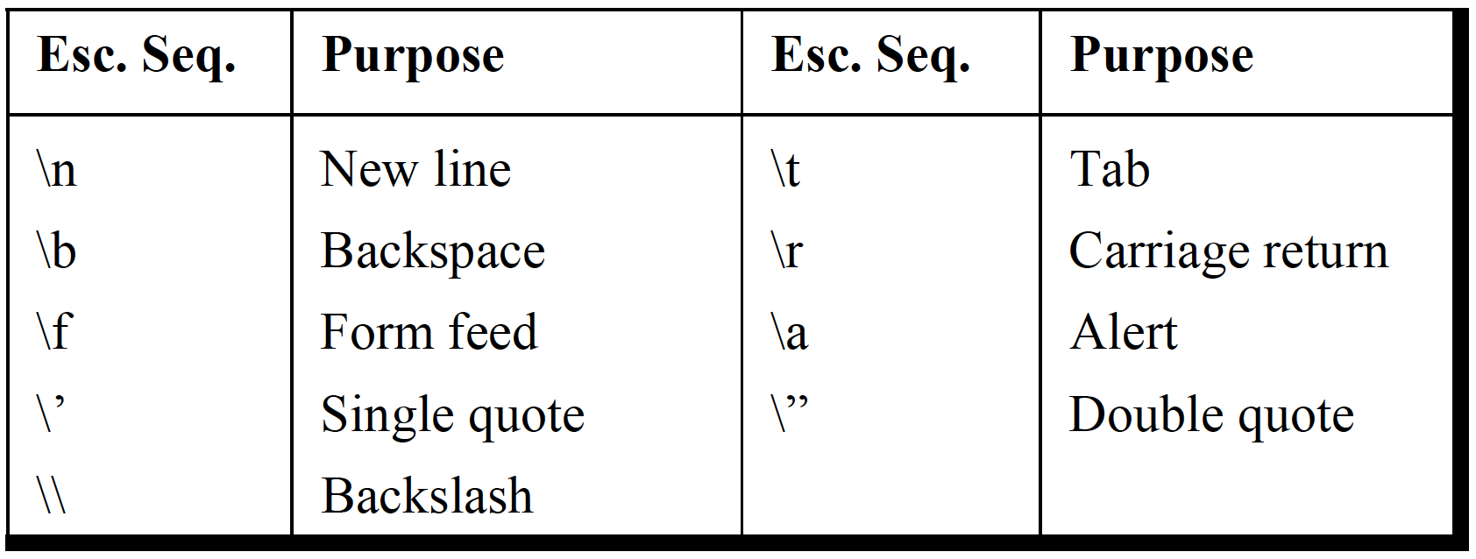
PrintF escape sequence
How do you print a % sign?
%%
Notes:
Use %%
printf(“%%”);
OUTPUT: %

Slide 4
Scanf
out = scanf(“%d”,&variable);
out contains the number of successfully scanned items. Is optional.
variable contains the value scanned using %d.
& is required. If you forget, the compiler does not note an error but displays a warning.
How can you use out?
Check if all the lines in a file have been read in
Why do you need a space before scanning %c?
Flushes input stream so other keys are not counted

Slide 5
Initializing variables
double scores;
variables are active and available as long as the braces or functions within which they are declared (statement above) are active.
If scores is defined in MAIN, its available so long as main() is active. When main() ends, the variables are forgotten.
If scores is defined outside any function, it is considered a global variable: a variable that is available to any function and is active as long as the code runs.
If scores is defined inside an user-defined function, its value is only available within that function. You need to somehow return this value to another function (say main()) to be useful (using return statement)

Slide 6
Declaring constants
#define constant_Name value
Constants defined cannot be changed as long as the code runs.
#include <stdio.h>
#define SIZE 20
int main(void){
int scores[SIZE];
return 0;
}

Slide 7
Arrays 1D
Predeclare their size: datatype var_name[SIZE]
int scores[20];
double grades[20];
char username[20];
Scanf(“%s”, &username);
If being assigned in the same line as declaration, SIZE is not required.
int scores[]={1,2,3};
char username[]=“Penguins”;

Slide 8
Arrays 2D
Predeclare their size: datatype var_name[SIZE1][SIZE2]
int scores[20][2];
double grades[20][2];
We have not covered/learnt how to create a 2 dimension character array.
If being assigned in the same line as declaration, SIZE1 is not required for first dimension, but required for all other dimensions (SIZE2).
int scores[][2]={{1,2},{4,5}};

Slide 9
UNIQUE property of arrays
int scores[20];
scores[0] = 12;
Arrays are a special type of pointer variables.
scores contains the address of the first element of the array. That is equivalent to:
scores = &scores[0]
Elements of an array are stored adjacent to each other in memory

Slide 10
Functions
Every function in C can return only ONE value.
Default value returned is of INT type. If a function return non-integer value, it should be declared in its definition or prototype.
void foo(void); //returns no value
int foo(void); //returns integer value
char foo(void); //returns char value
double foo(void); //returns real value
If a function returns a value, it should be terminated with a return statement within the function (last line). When a return statement is encountered, the function stops executing and return to the invocation point.
return value;
main() is also a function and returns 0 when successfully run.

Slide 11
FUNCTIONS
Can accept any number of values.
Must match the value being sent to function – read compiler warnings/errors to check if you are sending the correct value.
int foo(int scores, char name[], double age);
Here foo accepts three arguments and returns an integer.
Argument1: integer value and is stored in scores within this function.
Agrument2: character array (string) and is stored in name within foo.
Argument3: double (real/floating) value and stored in age within foo.

Slide 12
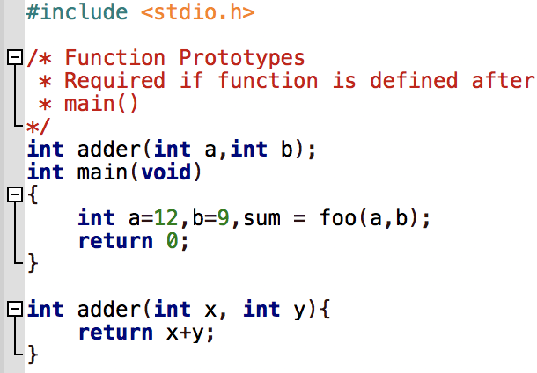
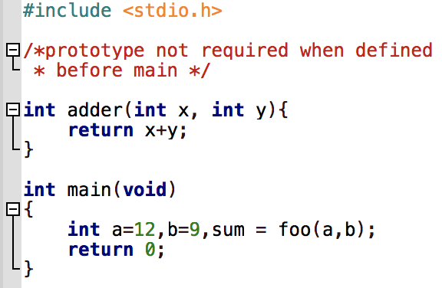
Sample

Slide 13
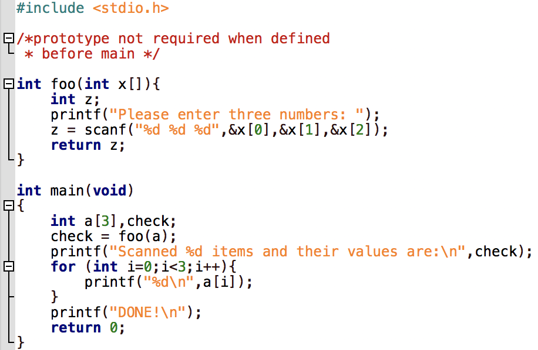
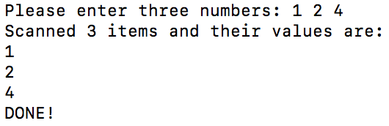
How to return multiple values?
Initialize an array in main()
Send array to function
Manipulate array values within function
NO RETURN REQUIRED FOR ARRAY! Why?

Slide 14
FILES
Create a variable to hold file address
FILE *fpin;
Use variable to assign file address to:
fpin = fopen (“data.dat”,”r”);
/*if file does not exist
fpin = NULL when mode is r
if mode is a or w, it creates a new file*/
r =. read only
a = append only
w = write only

Slide 15
Scanning values from file
Assume file address is held in fpin
To scan a value use fscanf
out = fscanf(fpin,”%d %d”,&a,&b);
Scanning starts at first character in file and only progresses forward.
To reset scanning location use fseek command (not covered) or fclose and fopen again.
What is value of out when fscanf reaches end of file?
-1 also labeled as EOF

Slide 16
Scanning values from file
FILE: a.dat and is stored in fpin in read mode
1 2 3
4 5 6
You can scan any number of characters at a time, the location moves by the last scanned item.
out=fscanf(fpin,”%d”,&a);
out=fscanf(fpin,”%d %d %d”,&a,&b,&c);
Fscanf(fpin, “%c”, &chara); will hold a \n character
_ points to current location in file
GREEN refers to scanned items
1_2 3\n
4 5 6\n
1 2 3\n
4 5 6\n
Notes:
_ points to current location in file

Slide 17
Read and write files in same code?
FILE *fpin,*fpout;
fpin = fopen(“data.dat”,”r”);
…//do your file read
fclose(fpin);
fpout = fopen(“data.dat”,”w”);
…//write new data in file (replace old data--”w” mode)
fclose(fpout);

Slide 18
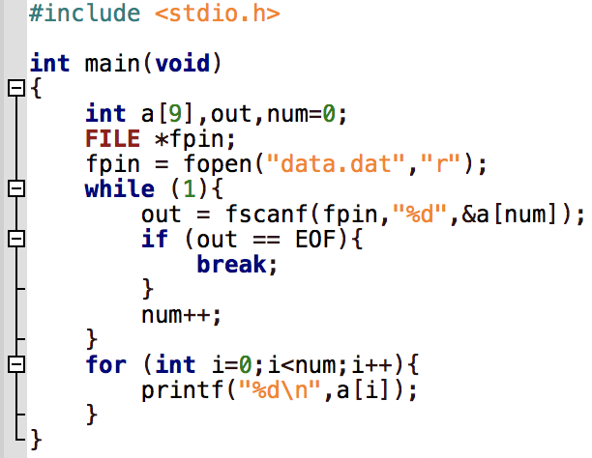
How to read file of unknown size?
OUTPUT:
data.dat:
1 2 3
4 5 6

